Slide 1
Understanding Heatwave Action Plan
Revenue (DM) Department,
Government of Telangana
Notes:
Ramagundam recorded 46.7 in 2015

Slide 2
Heatwave
“Spells of abnormally high temperatures that occur during April to June are referred to as heat waves”
45° C – Heatwave
47° C – Severe Heatwave

Slide 3
Heatwaves in Telangana
1986-1993 – Moderate (7-13 days)
From 1994 – Severe (19 days)
From 2003 – Very Severe (25 days)
From 2012 – Extreme (40 days)
In 2015, temperatures rise considerably, some times touching 47º C in the month of May
No of days in 2017 – Very Severe (23 days-IMD data).

Slide 4
EVER RECORDED MAXIMUM TEMPERETURES IN TELANGANA
EVER RECORDED EXTREME MAXIMUM TEMPERATURE VALUES IN TELANGANA
S.NO. | STATION | TEMPERATURE (˚C) | DATE
1 | ADILABAD | 46.8 | 05-06-1995
2 | BHADRACHALAM | 48.6 | 09-05-1973
3 | HANNAMKONDA | 47.8 | 03-06-2003
4 | HYDERABAD | 45.5 | 02-06-1966
5 | KHAMMAM | 47.6 | 22-05-2015
6 | MAHABUBNAGAR | 45.3 | 30-04-1973
 |  |  | 21-05-2015
7 | MEDAK | 46.3 | 18-05-2006
8 | NALGONDA | 46.8 | 22-05-2015
9 | NIZAMABAD | 47.3 | 22-05-2005
10 | RAMAGUNDAM | 47.3 | 24-05-1984

Slide 5
Heat wave fatalities over the years 2015-2017

Slide 6
HISTORICAL DATA ON HEAT WAVES IN TELANGANA
No. of Heat wave days in a month |  |  |  |  | Year wise
Year | April | May | June | Total | Deaths
2017 | 6 | 17 | NIL | 23 | 108
2016 | 10 (+2 in March) | 14 | 2 | 27 | 324
2015 | NIL | 13 | _ | 13 | 541
2014 | NIL | 4 | 15 | 19 | 31
2013 | NIL | 13 | NIL | 13 | 516
2012 | NIL | 15 | 8 | 23 | 144
2011 | NIL | 4 | 2 | 6 | 0
2010 | 21 | 16 | 9 | 46 | 11
2009 | 5 | 17 | 11 | 33 | 7
2008 | NIL | 1 | NIL | 1 | 17

Slide 7
Fatalities reported from districts - 2017

Slide 8
Hazard Risk Vulnerability Assessment (HRVA)
Hazard + Vulnerability
Heatwave + Deaths
Disaster
Role of Disaster Management
Thought Process on Risk Reduction
Heatwave Action Plan
Notes:
Notes : - Based on the expert Committee recommendations in 2003, we took the basis for vulnerability assessments and Hazardous nature of Heatwave led to preparation of HeatWave Action Plan in the year 2016

Slide 9
Telangana State Heatwave Action Plan
Identify vulnerable populations and the health risks specific to each group – EWS, women, children and elderly
Developing effective strategies, for agency coordination, and response planning to shape a Heat wave Action Plan that addresses heat-health risks;
Implementing the Heat Action Plan and activating heat alerts; and
Evaluating and updating the Heat Action Plan regularly.

Slide 10
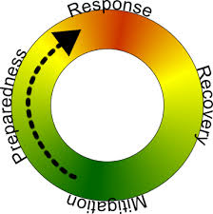
Implementation
Phase - I
Pre-Heat Season
January to March
Phase - II
During the Heat Season
April to June
Phase - III
Post-Heat Season
July to September

Slide 11
Nodal Officers
CDM & EOPS - Nodal Officer for State
District Collector - Nodal Officer) for District
Commissioner, GHMC - Nodal Officer for GHMC
Commissioner - Nodal Officers for Municipal Corporation/ Municipalities

Slide 12
Specific community preparedness
Training of Village level functionaries
Increase NGOs participation
Cooling centers – temples, public buildings, malls
Chalivendrams – Ambali/Java/Butter Milk centers, with support from community leaders
Awareness on Do’s & Don’ts

Slide 13
IMD - Monitor Temperature and Forecasts
Due to reduce span of winter an early onset and prolonged Heat wave conditions may prevail in the state – in 2018.
Need of the hour - Establishment of Thresholds – District specific.
Notifying heat alerts
Identifying high risk areas by mapping heat vulnerability in the state.
Identifying hot location/spots in Urban areas.
Notes:
The IMD /TSDPS to arrive at Thresholds before March for State to be prepared. The Map of IMD

Slide 14
Seasonal Temperature Forecast for Summer 2018-IMD
above normal temperatures (upto 1⁰ C) are likely to prevail over Telangana state.
Maximum Temperatures anomaly and Mean Temperatures anomaly for 2017 pre-monsoon season, above normal temperatures of 0.5 to 1 ⁰C are likely to prevail.
Minimum Temperature anomaly is above normal temperatures of 0.5 to 1 ⁰C are likely to prevail.
There is about 52% probability for maximum temperatures with above normal moderate and severe heat wave conditions are likely during the season.

Slide 15
IEC (Information, Education & Communication)
Advertisements
Hoardings
TV, Radio spots & jingles
Pamphlets
Press Conferences
SMS alerts – Bulk SMS, text alerts – social media, Facebook, Twitter, Whatsapp
Network – Private doctors, PHCs & CHCs.

Slide 16
Medical Preparedness
Supply of ORS, ice packs and IV fluids.
108/104 Emergency services
Issue of Health advisories
Ensure functioning of cold chain management.
Training to the ANMs/Anganwadi and ASHA workers
Telephone links to PHCs, CHCs & District General hospitals.

Slide 17
Activities – by Line Departments
LABOUR & EMPLOYMENT DEPARTMENT –
Suggested to shift timings for outdoor workers at peak afternoon hours (1pm – 5pm) during a heat alert.
Provide emergency ice packs and heat-illness prevention materials- to construction workers in high rise buildings.
ANIMAL HUSBANDRY DEPARTMENT -
Orient field workers from the Department of Animal Husbandry to reduce deaths among cattle/poultry/sheep due to heatwave – Issue of Advisories
Display posters / distribute pamphlets in villages, and important government offices
Ensure availability of adequate field staff during heatwave and ensure that they visit villages for follow up action.

Slide 18
Activities – by Line Departments
TRANSPORT DEPARTMENT (RTC, Metro Rail, Railways)
Display posters & distribute pamphlets on prevention of heat related illness (Do’s and Don’ts)
Ensure availability of shades in Bus stops, Bus Stations; Provide cool drinking water and availability of ORS in identified locations.
Establish Health teams at major bus stands / Terminals and other public places
Provide emergency ice packs and heat-illness prevention materials to TSRTC staff (Drivers, Conductors) etc.

Slide 19
Activities – by Line Departments
Education
All schools to display posters on Do’s and Don’ts & distribute pamphlets on prevention of heat related illness in Schools and Colleges.
Identify shelter space, drinking water, ORS facilities with signs.
Ensure that Schools do not function during peak hours (12-4 pm) when Heatwave is declared.
No open air classes to be conducted.
Forest and Environment: Actions to reduce incidences of forest fire and ensure water availability in forests for wild animals

Slide 20
Information Technology (IT)
Dynamic Online/web portal for Heatwave action plan http://dm.telangana.gov.in/Heatmap/Measures%20from%20Heatwave.jsp
Data from 885 AWS sensors from TSDSP. Tsdps.plg@gmail.com
Activities displays on dashboard /interface/ online monitoring tool
Mapping the Hospitals, Schools, Public offices
Activate Heatwave App
TSDPS to provide daily weather data to Rev (DM

Slide 21
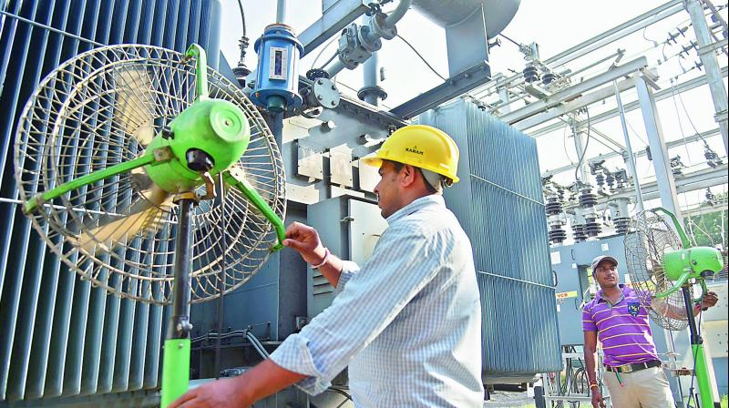
Specific Action by Stakeholders
District specific alerts by IMD.
Fixation of thresholds in coordination with IMD, TSDSP & IT Department
Creation of WhatsUp group – TS Disaster Management Group (for early dissemination and real time monitoring)
Hyderabad City – GHMC to prepare City specific Heatwave Action Plan.
Notes:
Inter agency group is a network of International NGOs, UN agencies, CSOs and NGOs who support the state and affected communities during emergencies.
Fans installed beside transformers at Gymkhana sub-station to overcome excessive heating conditions witnessed this summer.923rd MAY 2015 E TELANGANA

Slide 22
Specific Action by Stakeholders
Providing funds to I&PR Department for IEC materials like Posters, Pamphlets, TV scrolls and Video Clippings.
Engaging CSOs, NGOs in dissemination of information and Emergency follow-up
Stakeholders workshop – Media, Officials from Districts and Inter Agency Group
Strengthen activities done in 2017
Notes:
Inter agency group is a network of International NGOs, UN agencies, CSOs and NGOs who support the state and affected communities during emergencies.

Slide 23
Measures taken by the State in 2017
Workshop was conducted for officials of line departments to disseminate the Heat wave action plan at MCR-HRDI. State Organised National Level Conference on Heatwave in 2017 in collaboration with NDMA
Orientation conducted for district level officials on heatwave action plan in Warangal, Adilabad, Medak and Khammam Districts covering around 300 Officers.
IEC materials used or publicity - Posters, Pamphlets, flexi boards and banners and radio jingles in all ten Districts (present 31) and Print media.
Three member committee formed to ascertain heatwave deaths. Apathbandhu Scheme in place
The Education Dept revised the school timings in-view of heat wave alert.
The IT department prepared ‘’The Telangana State Disaster Management Control Portal ‘’
Chalivendrams were organised by the State with support from CSOs, NGOs and Private companies.
Veterinary Dept field staff has activated.
Notes:
Portal : with data such as max/min/average temperatures , humidity and wind speed recorded by 885 AWS sensors deployed across the state.

Slide 24
Outcome of implementation of heatwave action plan
“Ensure zero deaths and reduce health casualties that may arise from prevailing Heatwave conditions”

Slide 25
Suggestions for effective implementation
Thank you

